Slide 1
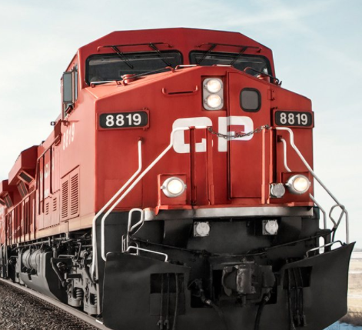
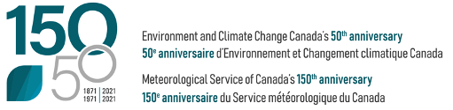
OBRS Cloud Physics Research Program “Kick-off” Meeting
July 22, 2021 (virtual)

Slide 2
Departmental Mandate
ECCC’s core responsibility is to “monitor weather, [...] provide forecasts, information and warnings to the Canadian public, [...] conduct research, develop and maintain computer-based models for predicting weather, and collaborate [...] with other national meteorological services and with international organizations”
(2021-22 ECCC Departmental Plan)

Slide 3
OBRS Function Mapping across Delivery on Mandate for MRD/ASTD: Flowchart of activities

Slide 4
OBRS Function Mapping across Delivery on Mandate for MRD/ASTD: Research activities
OBRS Scientific Research
Aircraft program
Radar program
Cloud Physics program
Nowcasting/HIW program
Deliverables:
Policy and regulations
Knowledge of weather and hazards for products and services
as announced at last OBRS all-hands meeting
recall: any given project should fall into 1 or more of the 4 research programs

Slide 5
AGENDA
Introductory comments
Individual presentations – inventory of what are each of us doing (w.r.t. CP)
Discussion
Identify common CP sub-topics (areas of overlapping individual research)
Wish-list – other potential CP sub-topics (relevant to OBRS but not yet on-going)
→ Specify the CP research sub-topics (and objectives) that define the program

Slide 6

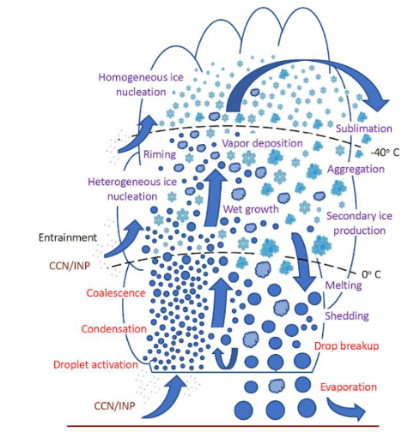
Cloud Physics – What does this include? (relevant to OBRS)
cloud (and precipitation) microphysics

Slide 7
Cloud Physics – What does this include? (relevant to OBRS)
cloud (and precipitation) microphysics
atmospheric radiative transfer
Solar radiation
Infrared radiation

Slide 8
Cloud Physics – What does this include? (relevant to OBRS)
cloud (and precipitation) microphysics
atmospheric radiative transfer
Also:
remote sensing / in situ measurements
representation in models
(as related to the CP research program)
Solar radiation
Infrared radiation

Slide 9
OBRS Function Mapping across Delivery on Mandate for MRD/ASTD: Research activities
OBRS Scientific Research
Aircraft program
Radar program
Cloud Physics program
Nowcasting/HIW program
Deliverables:
Policy and regulations
Knowledge of weather and hazards for products and services

Slide 10
OBRS Function Mapping across Delivery on Mandate for MRD/ASTD: Research activities – alternative view
OBRS Scientific Research
Cloud Physics program
Nowcasting/HIW program
Cloud/precipitation microphysics;
Atmospheric radiative transfer
0-6 h forecasting (includes monitoring);
post-processing
Emphasis on high-impact weather
Fundamental research
Remote sensing
Representation in models
monitoring and
predicting weather
Observations
1. Ground-based
Radar program
Other remote sensing (e.g. lidar)
In situ (e.g. distrometer)
2. Aircraft Program
3. Space-based
Policy
NWP
(RPN/CCMEP)
predicting weather
Validation of
remote sensing

Slide 11
OBRS Function Mapping across Delivery on Mandate for MRD/ASTD: Defining the Cloud Physics research program
Cloud Physics program
Nowcasting/HIW program
Cloud/precipitation microphysics;
Atmospheric radiative transfer
Fundamental research
Remote sensing
Representation in models
AGENDA of meeting:
Inventory of current CP research
- What are we doing now? (individual presentations)
- What are the main CP research sub-topics?
- What is missing?
Goal: To define clearly the OBRS CP program
- Specific research objectives, deliverables, clients
- Identify resource gaps
Observations
Policy
NWP
(RPN/CCMEP)

Slide 12
AGENDA
Introductory comments
Individual presentations – inventory of what are each of us doing (w.r.t. CP)

Slide 13
Polarimetric weather radar research and applications(1/2)
SUDESH BOODOO
Development and tech transfer of dual polarization (DP) radar algorithms for Canadian S-band radars with focus on improvements to PARCA and QPE products.
Implementation and evaluation of polarimetric snow QPE algorithms.
Development and tech transfer of a radar-based surface particle type product (SPTP), incorporating RDPS/HRDPS model parameters.
Assessment of DP radar measurements and products for significant weather cases. Detailed analysis for case studies e.g. tornado, severe hail, flooding etc.
Evaluation of DP attenuation correction algorithm implemented in fall 2020.

Slide 14
Polarimetric weather radar research and applications(2/2)
SUDESH BOODOO
Implementation and evaluation of NWP model 2D melting layer for PARCA and QPE with ongoing improvements and revisions.
Develop and apply improved post processing of differential phase and K_{DP} derivation.
Verification of operational radar rain and snow QPE algorithms for Canadian S-band radar network. Evaluation with surface measurements, CAPA, field study data.
Perform and report on case study evaluations of SPTP with CMDM and CMOI.
Evaluate PARCA and SPTP outputs with METAR observations in EMET.
Develop and evaluate DP radar data quality, e.g. Z_{DR} biases, system phase, noise corrections etc. as it relates to algorithm development and performance.

Slide 15
The current research activities
FAISAL BOUDALA
Compare the cloud fraction retrieved using passive and active satellite sensors on a global scale to understand weakness and strengths of the passive seniors capturing the climatology and spatial distribution of clouds and associated cloud phase.
Satellite-based evaluation of NWP model clouds using a number of statistical tools including satellite simulators.
Develop radar snowfall and extinction retrieval algorithm that includes dual-polarimetric parameters such as Differential Phase and Specific Differential Phase in addition to reflectivity factor.

Slide 16
Publications in progress
FAISAL BOUDALA
Evaluations of the climatology of three latest cloud satellite products based on passive sensors (ISCCP-H, two CERES) against the CALIPSO-GOCCP.
Evaluation of CanESM models cloud and cloud type climatology using the ISCCP, and CALIPSO-GOCCP cloud products.
Measuring visibility, cloud Ceiling, and humidity at Cold Lake, Alberta and visibility parameterization.

Slide 17
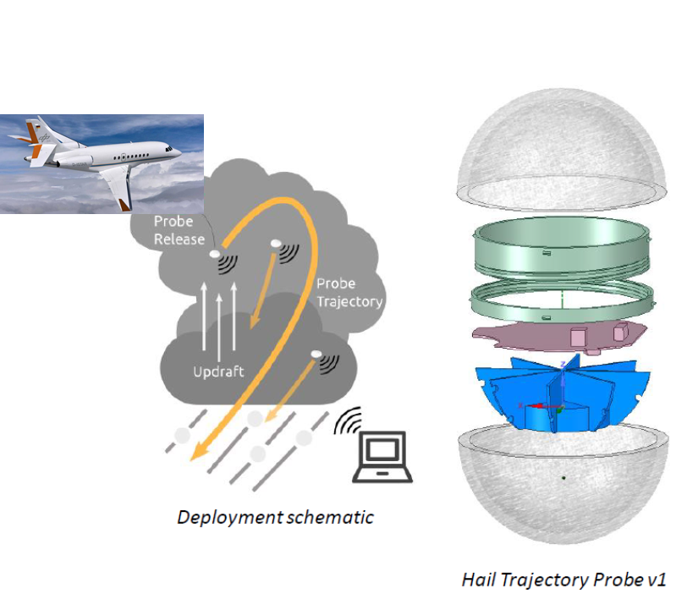
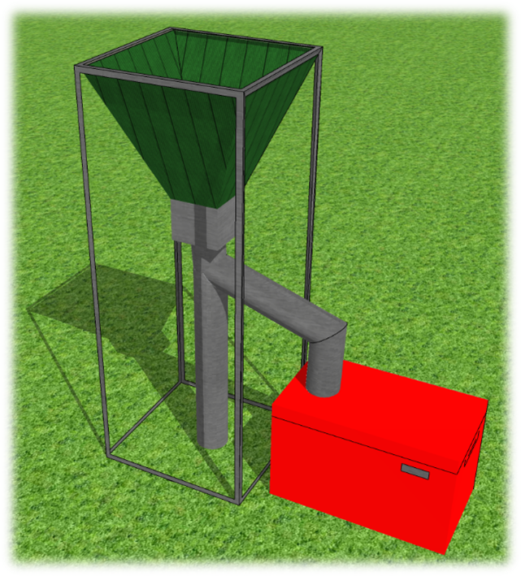
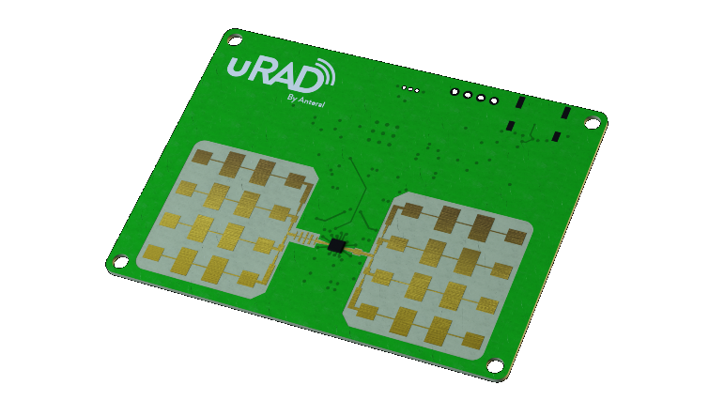
Current and FUTURE HAIL Research
JULIAN BRIMELOW
Fall speed of large natural hail: optical, CW radar, stereo camera +AI). Simpson
Fall modes and speed of ice replicas from 3D prints in iFLY wind tunnel. (Heymsfield and Giammanco)
Growth of giant and gargantuan hail. (Kumjian, Soderholm)
In-situ measurements using a hail pod (LoRa, GPS). (Simpson, Kumjian and Soderholm)
Identifying hail size (and/or hail amount) using conventional and DP radar data. Disdrometer, hail pads & hail collection system for validation. (Boodoo)
Improving forecasts of hail using NWP model data & HAILCAST => CM1. (Kumjian)
Melting of hail, apply to in-storm T-28 hail data. (Heymsfield)
Soderholm et al.
3 cm
Heymsfield, Szakáll, Jost, Giammanco, Wright & Brimelow (2020, JAS)

Slide 18
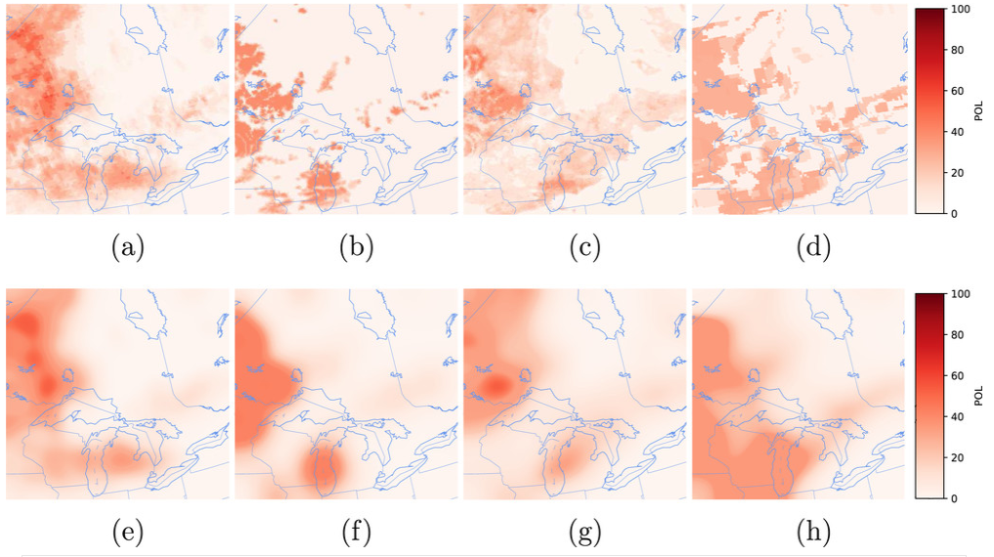
1. Post-processing of physical models
DOMINIQUE BRUNET
Example [1]:
REPS
RDPS
Frénette
Kain–Fritsch
Sills-Taylor
Burrows
0.91
0.77
0.82
0.80
Transfer function
Physical model
Calibrated
Prob. of Lightning
$$y=T(f\left(x\right))$$
Observed output
Input
0.93
0.93
0.91
0.92
Smoothed
& Calibrated
Prob. of Lightning
Forecasts shown: 1200 UTC +12 h 12 Jul 2015
Observations (not shown): Lightning detected by CLDN within 25km radius
ROC-AUC statistics for August-September 2015
[1] Brunet, D., Sills, D., & Driedger, N. (2019). On the Evaluation of Probabilistic Thunderstorm Forecasts and the Automated Generation of Thunderstorm Threat Areas during Environment Canada Pan Am Science Showcase, Weather and Forecasting, 34(5), 1295-1319.
D. Brunet

Slide 19
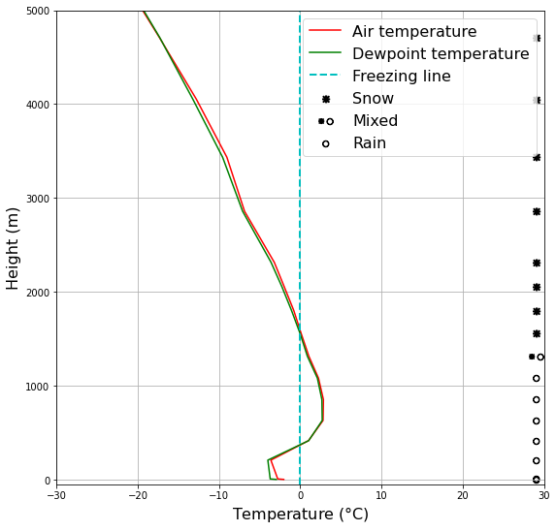
2. Physics-informed/Explainable AI
DOMINIQUE BRUNET
Physics-informed AI model
$$y=f\left(x\right)$$
Observed output
Input
No more AI black box!
Predictands
Predictors
Physics-informed AI
Why a prediction was made? Why not another one?
What is the confidence in the prediction?
For what types of events the AI succeeds/fails?
Domain knowledge expertise needed to design physical constraints
D. Brunet

Slide 20
BILL BURROWS
Bill Burrows: Current Research Interests Pertaining to Cloud Physics (Sort of)
A) Forecasting high-impact weather elements not directly forecast by NWP models: A-1) with models developed with predictors derived from NWP model output data 1) Dense fog and low-ceiling stratus 2) Lightning 3) Blizzards A-2) with physics-based models driven with standard NWP model output fields 1) Hailcast 2) Precipitation type A-3) Deriving synthetic climatology in remote areas with near-term forecasts from models in A-1 … e.g. Arctic land and marine areas 1) Dense fog and low-ceiling stratus 2) Blizzards
B) Bringing forecasts from new models to operational forecasters via websites and NINJO; adding their requests for new research items to the websites
http://weg-hal-fe01.edm.ab.ec.gc.ca/WxProducts/HAL_Winter http://weg-hal-fe01.edm.ab.ec.gc.ca/WxProducts/HAL_Fog http://weg-hal-fe01.edm.ab.ec.gc.ca/WxProducts/HAL_Convection/RSD.html https://web.science.gc.ca/~dab000/summer_severe/summer_severe_page.html

Slide 21
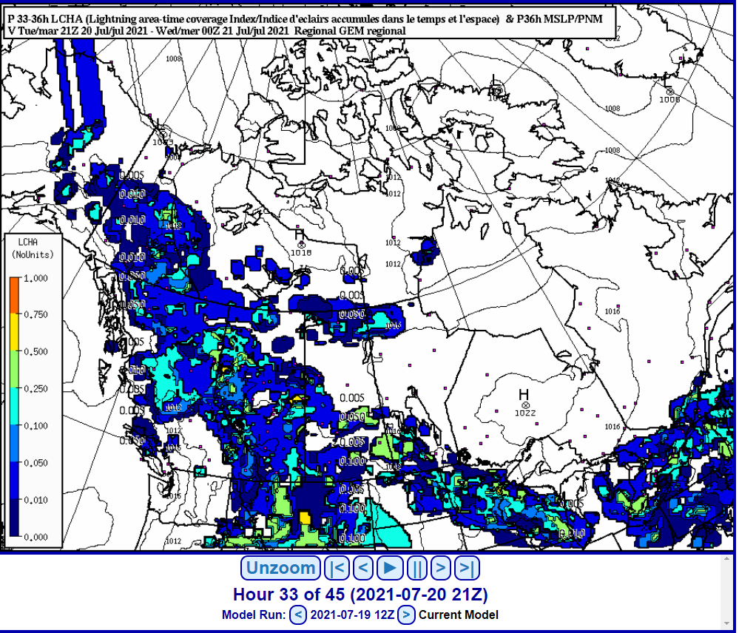
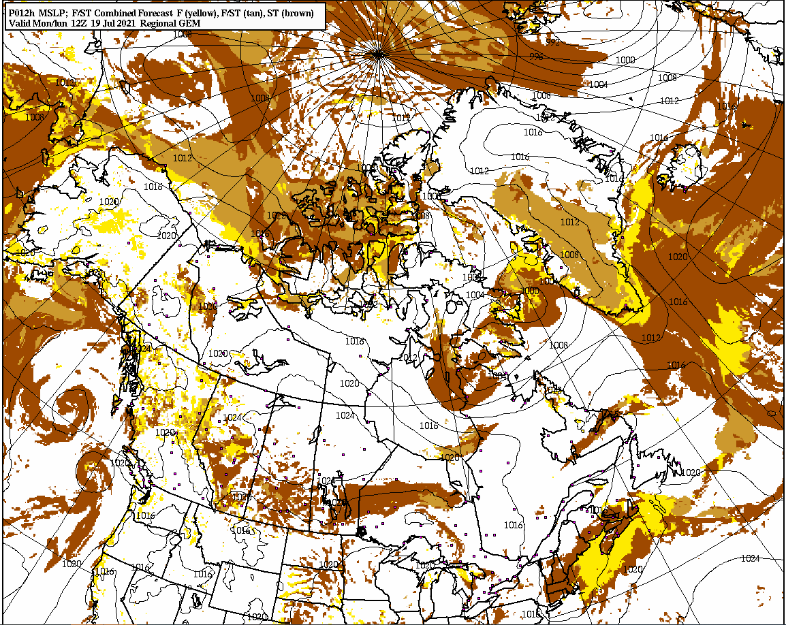
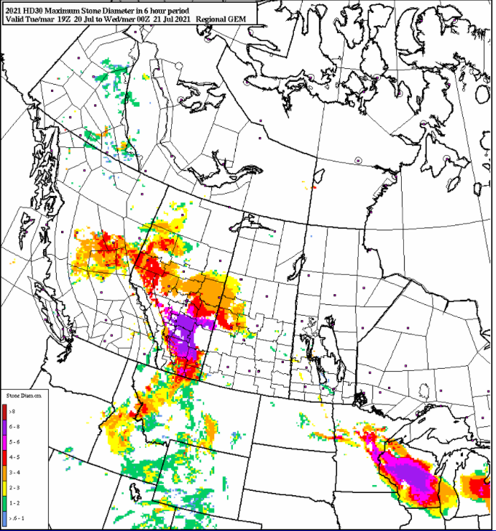
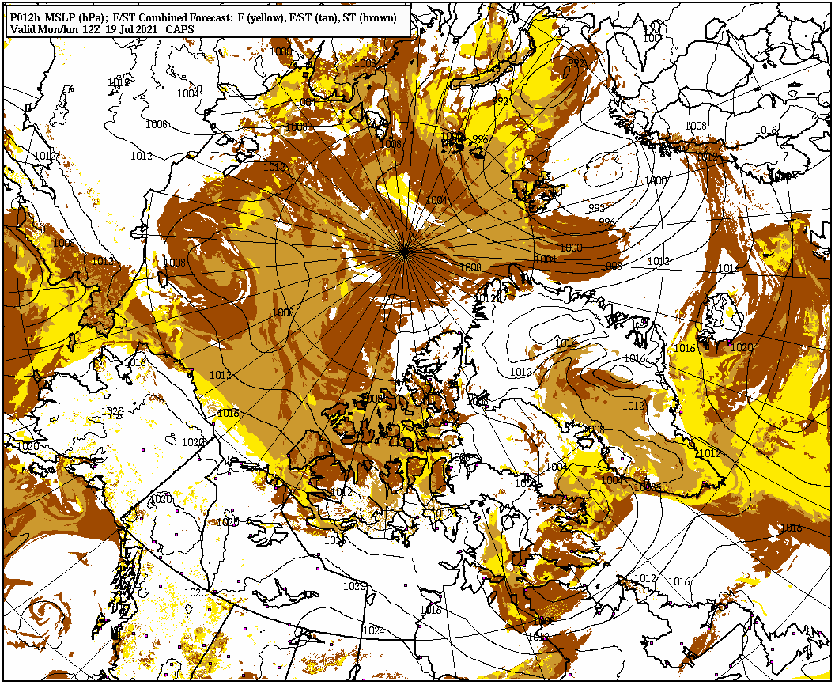
BILL BURROWS
F/ST RDPS
L
IGHTNING
F/ST CAPS
HAI LCAST

Slide 22
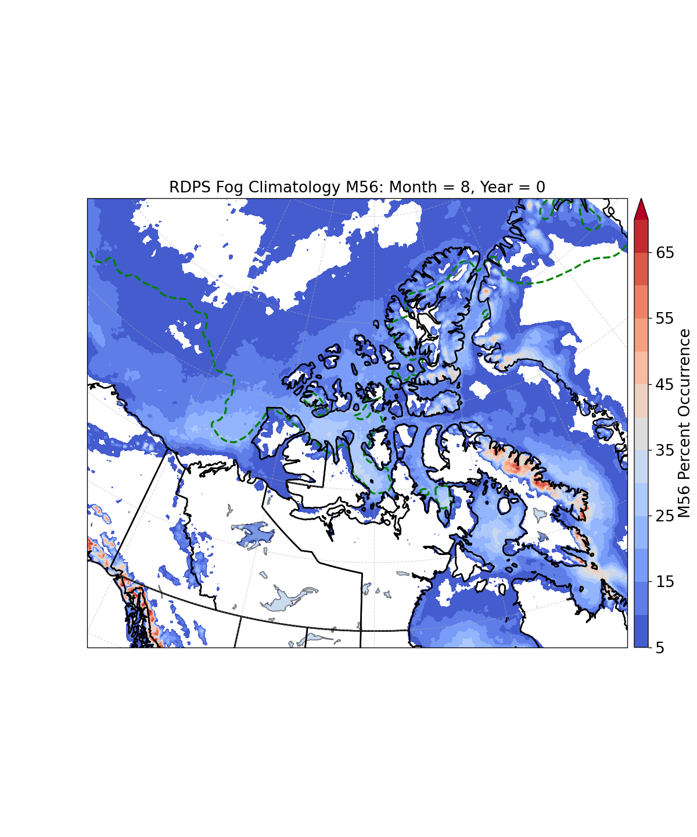
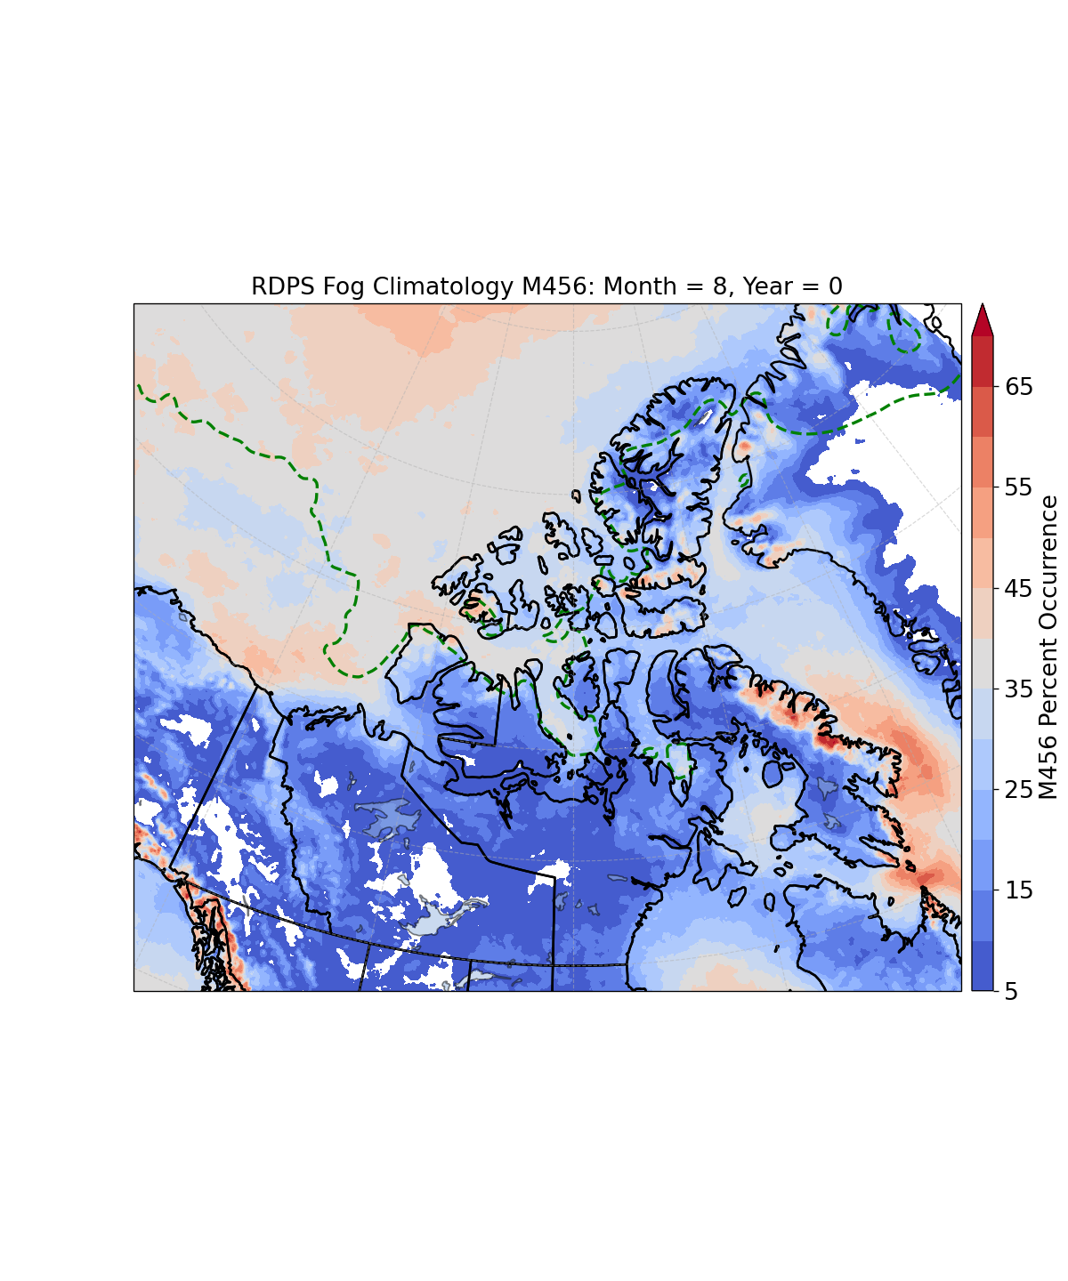
BILL BURROWS
SYNTHETIC CLIMATOLOGY AUGUST 2016-2020 USING 6-17 hr RDPS F/ST FORECASTS
Occurrence (%)
50% ice cover
Dense Fog
Dense fog OR low stratus
Note: >30% Foxe Basin, Vt. Melville Sound, McClure Strait, G. of Boothia, northern Beaufort Sea
>50% Davis Strait; >40% McClure Strait, northern Beaufort Sea
extensive ST cover over Davis Strait and the ice-covered Arctic Ocean

Slide 23
NORMAN DONALDSON
Apply cloud physics knowledge to improve radar measurements. Initially improving radar configuration and post-processing. Then, application of radar to case studies, with focus on the origin of radar quality issues in specific situations.

Slide 24
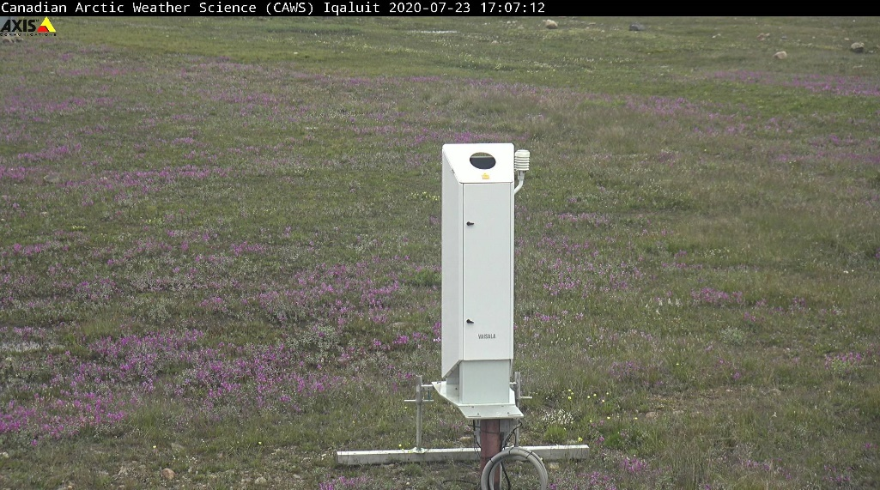
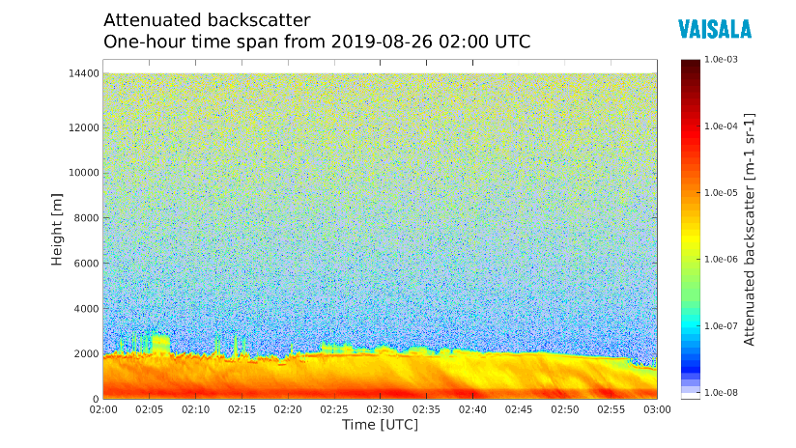
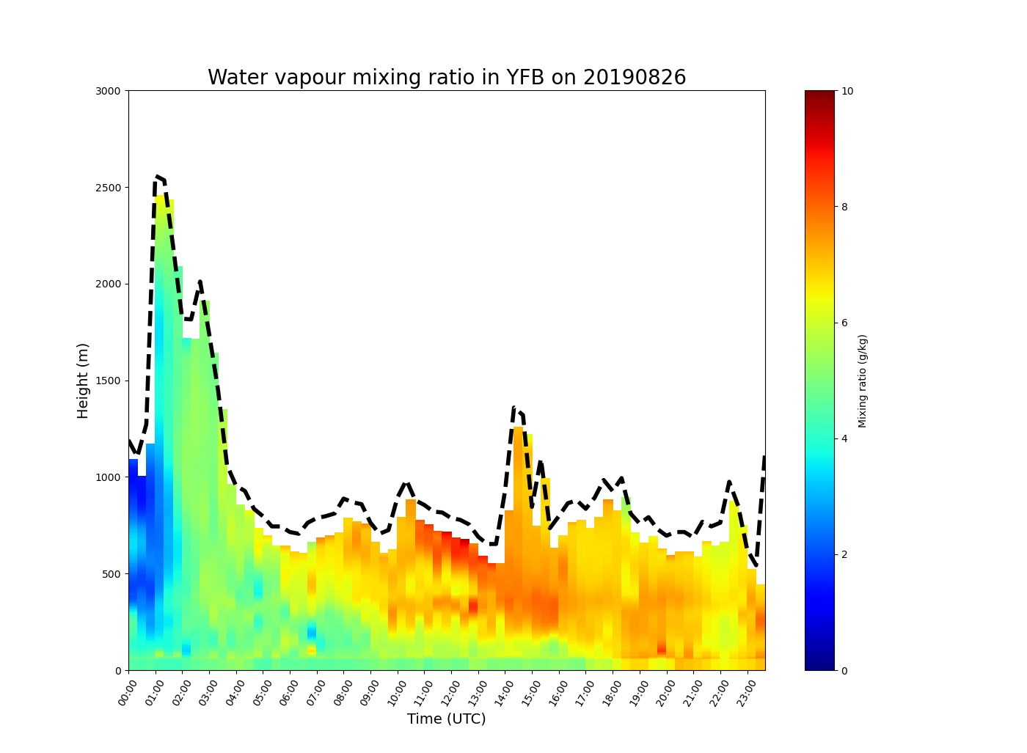
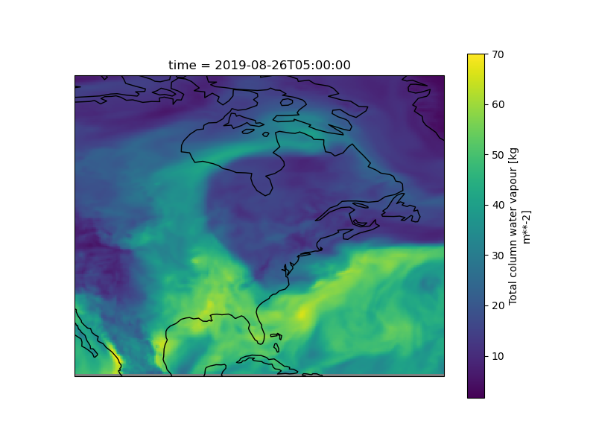
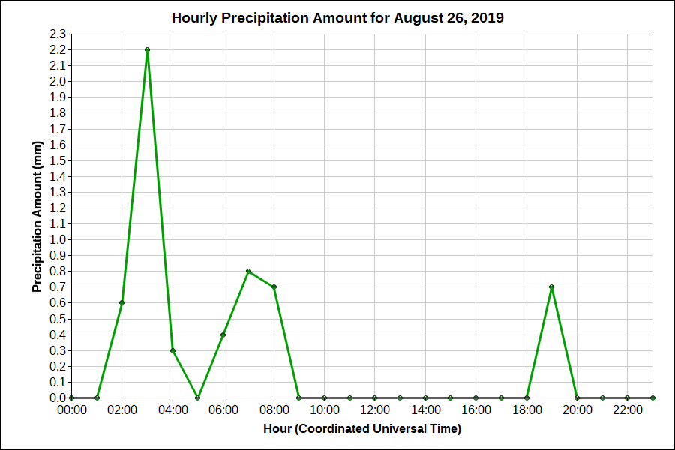
Lidars in Cloud Physics
Shannon Hicks-Jalali
Vaisala DIAL
How can we apply lidar observations to cloud physics problems?
Current work:
Diurnal WV cycles in the Arctic w/DIAL and GPS
Atmospheric Rivers in Iqaluit
Validation of the DIAL during precipitation
Using lidars to determine precipitation type (w/Dominique)
Potential Areas of Research using WV/Backscatter Profiles:
Water vapour boundary layer processes
Thunderstorm initiation
Model evaluation
Cloud height/boundary layer height
Estimates of cloud thickness
Energy budgets/fluxes
Potential external depol lidar data source (MPLNET):
https://mplnet.gsfc.nasa.gov/data.cgi?
ERA5 IWV Field
Shannon.Hicks-Jalali@canada.ca

Slide 25
IGOR GRISHIN
2021-07-19
Research Supervisor Dr. Alexei Korolev
Research Objectives:
Objective 1: ECCC undertakes efforts to perform comprehensive laboratory calibrations of imaging particle probes, which are required for analysis of in-situ data. The laboratory setup was developed during previous years. The calibration will be performed with a custom-made spinning glass discs with a repeated patters of monodisperse dots masked on their surfaces. The ultimate goal of this work is to develop size-retrieval algorithms for out-of-focus particle images and their positioning in the sample volume (not too much results yet to show).
Objective 2: Hot-wire instruments are widely used by cloud physics and wind tunnel communities for measurements of bulk liquid (LWC) and ice (IWC) water content. One of the important problems in the calculations of LWC and IWC from the hot-wire measurements is identification of the zero-bias offset, which is known to be function of airspeed, pressure and temperature and determine the so called “convective heat losses”. This work is a continuation of the work started in FY2020-21 (see slide 2 in application to SPICULE data).
Objective 3: Radar measurements are widely used by the cloud physics community for retrievals of cloud microphysics of clouds. One of the important tasks related to such retrievals is to develop of conversion of in-situ microphysical measurements into radar reflectivity. The goal of such calculations is to facilitate interpretation of weather and airborne radar measurements (see slide 3 in application to ICICLE data).

Slide 26
IGOR GRISHIN
SPICULE Experiment:
Estimation of the Hot-Wire Sensors Baseline Drift with preselected Clear Sky Data

Slide 27
IGOR GRISHIN
ICICLE: Radar Reflectivity (W-band) & LWC Retrievals
ICICLE Flight 20 February 23, 2019
Horizontal Polarization
Aspect Ratio = 0.25
Aspect Ratio = 0.6

Slide 28
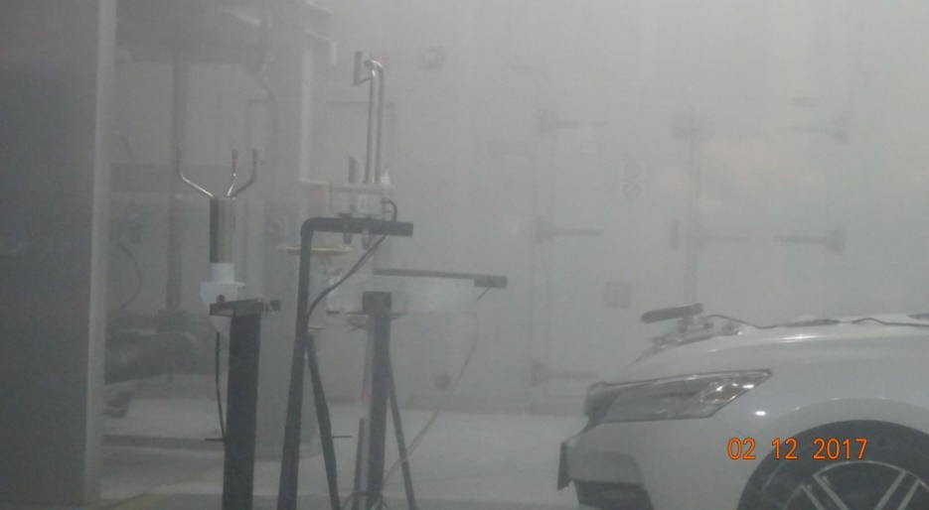
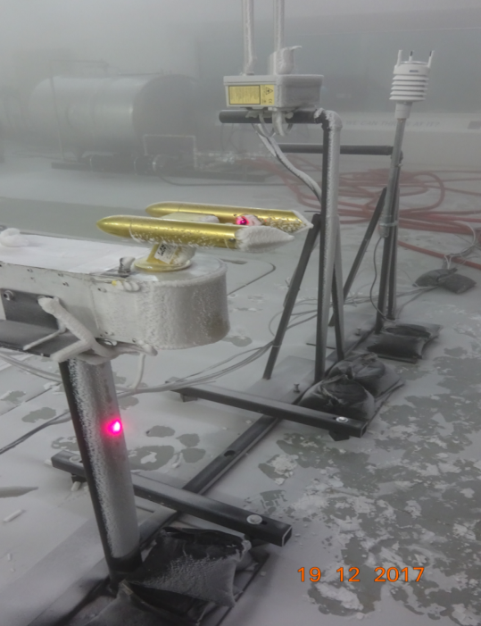
1. Vis due to FG and Precip
ISMAIL GULTEPE
Applications
Marine environments
Aviation/Transportation Operations
New tech development
Projects involved
-C-FACT field project for mountain visibility (Uni of Utah)
-C-FOG marine fog/precip visibility (Uni of NDU)
-Climatic wind tunnel experiments (Ontario Tech Uni) and extreme weather (high-low T, gust, icing, frost, vis)

Slide 29
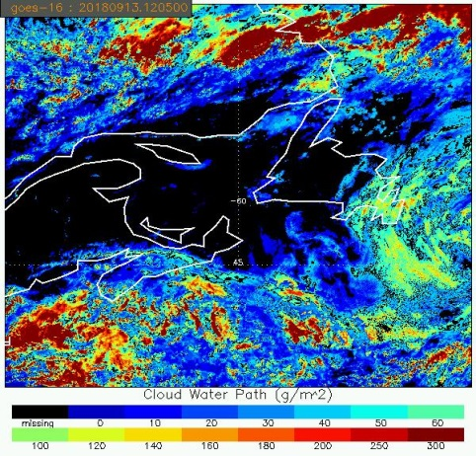
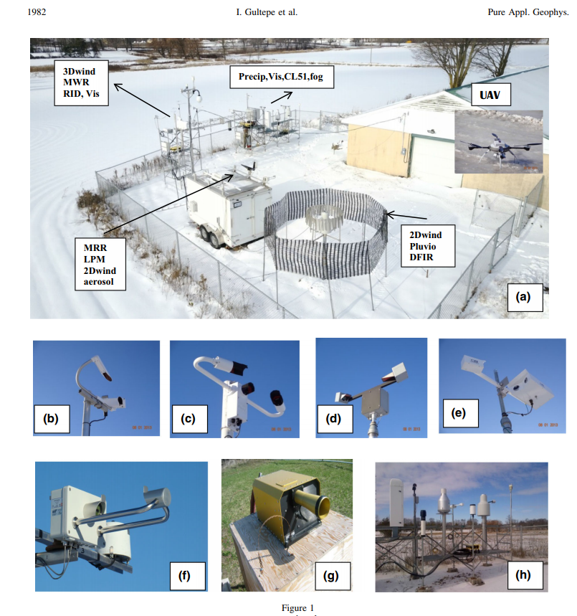
2. Supersite observations for NWP and RSR validations
ISMAIL GULTEPE
Activity
NWP validations
Remote sensing validations (radar/satellite)
Microphysical parameterization development
Ground based icing/precip types
Focused areas
- Visibility due to FG, RN, SN, BSN
- Mixed precip; FG/RN/DRZL/SN
- Ground base icing/deicing
- SN/RN characterization
- Gust/turbulence
- IN and CCN effects on clouds

Slide 30
ALEXEI KOROLEV
Major directions
Theoretical and observational studies of cloud processes
Policy and regulations, aviation safety
Airborne measurements
Instrumentation and data processing
Cloud Processes (Theoretical themes)
Droplet size distribution broadening dynamics: the effect of the Ostwald ripening, the effect of supersaturation fluctuations and isobaric mixing in a turbulent environment.
Development of a theoretical framework for homogeneous and inhomogeneous mixing. Relation to the Damkhöller number.
Development of a theoretical framework for phase partitioning in three-phase colloidal systems (mixed-phase clouds). Development of a theory of persistent mixed-phase clouds. Identification of two more conditions for partitioning of ice and liquid phases besides the Wegener-Bergeron-Findeisen process.
Development of a physically based parameterization of CCN activation at the cloud base, based on analytical solution for maximum supersaturation at the cloud base.
Cloud Processes (Observations)
Statistics of different microphysical parameters in liquid, ice and mixed-phase clouds.
Relative humidity in ice, and mixed-phase clouds.
Statistics of ice particle habits.
Observations of secondary ice production.

Slide 31
ALEXEI KOROLEV
Policy and regulations
Supporting aviation regulatory agencies (FAA, TC) in defining freezing drizzle and freezing rain icing environments for certification of a new type aircraft design (14 Code of Federal Regulations (CFR) Appendix O to Part 25 (Airworthiness Standards: Transport Category Airplanes)).
Supporting international aviation regulatory agencies (FAA, TC, EASA) in defining ice crystal icing environments and engineering standards for certification of a new type aircraft design (14 CFR Appendix H to Part 25 (Airworthiness Standards: Transport Category Airplanes)).
Supporting the international wind tunnel community in developing measurement standards for supercooled liquid sprays and ice.
Airborne instrumentation
Redesign of a hot-wire Nevzorov probe and adapting it for airborne and wind-tunnel operations.
Design of an array of hot-wire sensors for LWC and TWC measurements.
Design of an airborne cloud extinction probe.
Design of anti-shattering tips (Korolev tips) for particle probes (patented).
Design of a technique for calibrations of scattering probes by monodisperse droplets.
Develop a theoretical framework of binary digital images in OAPs based on Fresnel diffraction. Corrections of particle sizes measured by OAPs.
Theoretical framework of ice growth on icing cylinders.
Field deployments
Deep experience in deployment, integration and operation of airborne instruments in harsh environments.
Participation in over 40 airborne and wind tunnel campaigns.

Slide 32
CP-related research
ZEN MARIANI
Continuous high-res cloud (vertically-resolved), fog, and precipitation observations at Iqaluit, Whitehorse, & Squamish sites (since 2015/2018)
Utilize existing dataset for Arctic / mountain meteorological studies
Most instruments are being redeployed ASAP (COVID) – where to?
Radiation:
Long- and short-wave radiation flux sensors at Iqaluit since 2018
Can measure surface cloud radiative effect
Can combine with cloud cover observations (cloud base height, dpol ratio, AERONET aerosol optical depth, vertical velocities, 2D wind profiles, surface precip)
Downwelling Far Infrared observations in Iqaluit (thin-ice clouds, IR budget, etc.) with the FIRR
In collaboration with J-P. Blanchet & Ph.D. Thesis for L. Pelletier (UQAM)
Microphysical properties:
Can analyze mixed-phase clouds & model representation evaluation
Interest from Ny-Ålesund site (K. Ebell, U Cologne) to collaborate on a research project
Utilize multi-wavelength aerosol profile observations at the CAWS supersites
e.g., colour ratio (β_{radar}/β_{lidar}) can provide info on type of aerosol
Utilize observations from the Doppler lidar Mesonet (next slide)
Satellite cal/val:
ADM-Aeolus (collaboration with P. Kushner, UofT) & GPM satellites
Focus has been on winds / precip observations; can also focus on CP?

Slide 33
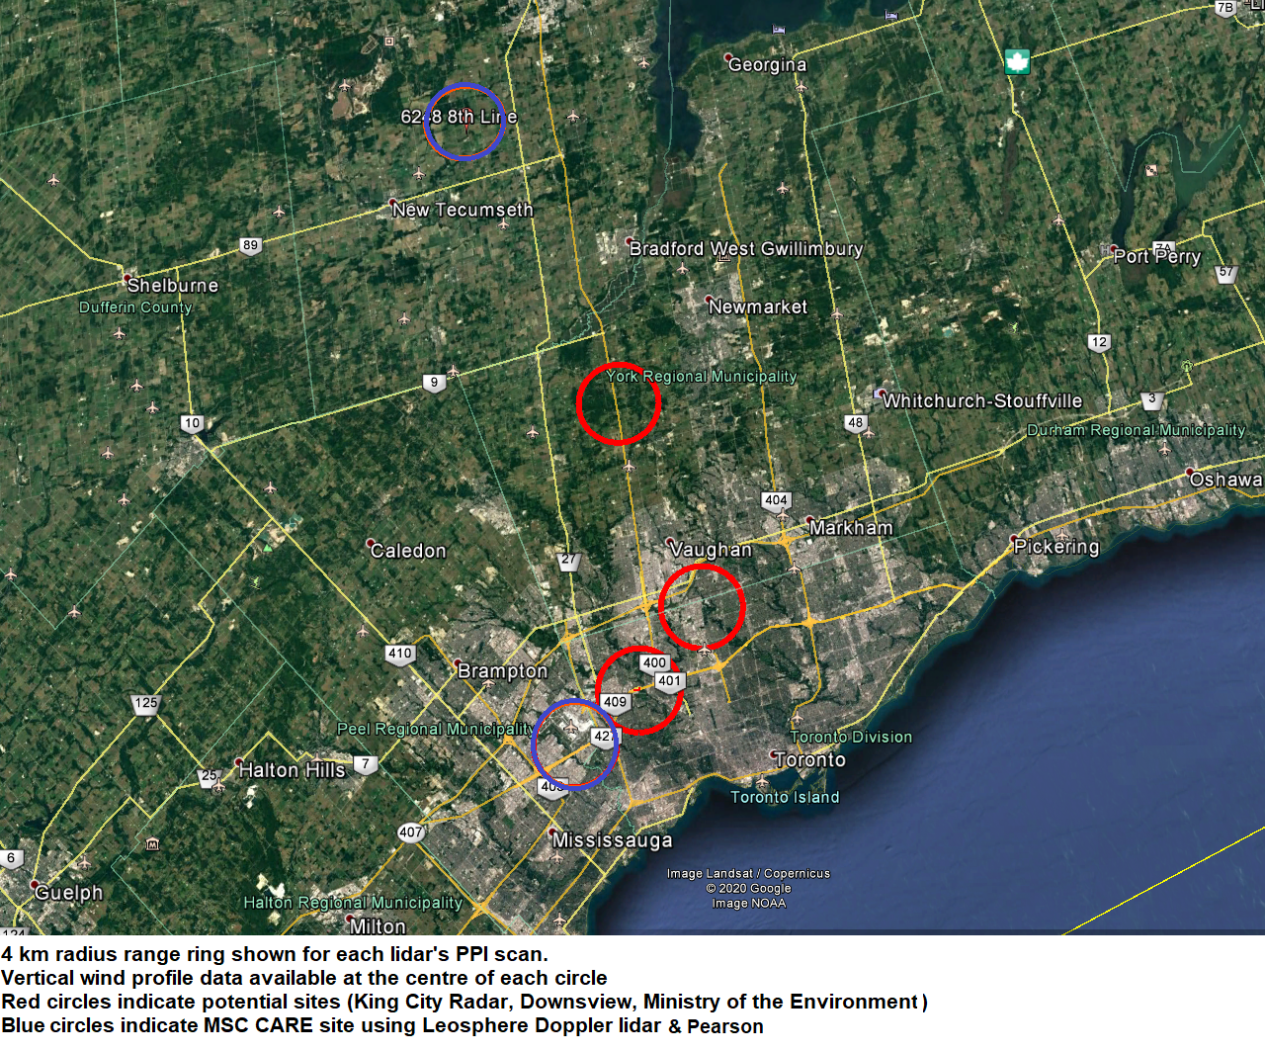
Doppler lidar Mesonet during the SWAPIT campaign (2022-2023+) Focus is to test assimilation of winds into NWP; can we use the other obs?
ZEN MARIANI
Existing MSC lidar
Obs @ each site:
-Wind profile (uu, vv, zz) incl. vert. velocities
-Depolarization ratio (%)
-Aerosol backscatter (β) profile
-Cloud base height
-PBL height estimate
MRD lidar + King Radar
2nd MSC lidar
MRD lidar
3rd MSC lidar
MRD lidar at UofT downtown and/or Scarborough campus

Slide 34



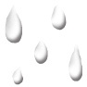

DANIEL MICHELSON
“Down-to-Earth” radar-based QPE
Concept
8 km
7
6
5
4
3
2
1
0
Radar dBZ --> R
Autoconversion
Coalescence
Local ice production
Ice collecting rain & snow
Model levels
Evaporation
Surface QPE
0 60 120 180 240 km
Michelson et al., (2005) https://doi.org/10.1256/qj.03.203
Used Rasch & Kristjánsson (1998) microphysics scheme

Slide 35
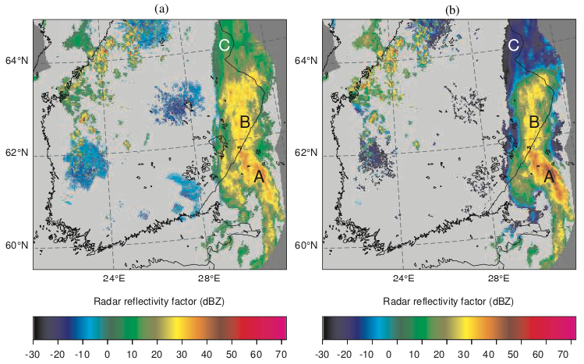
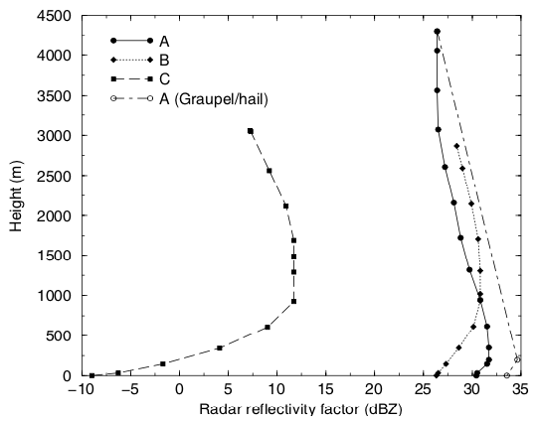
DANIEL MICHELSON
“DTE2”
Use radar to initialize a precipitation microphysics model,
e.g. P3, to model the radar echo aloft down to the surface.
before
after

Slide 36
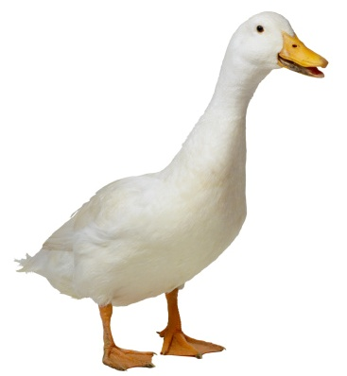
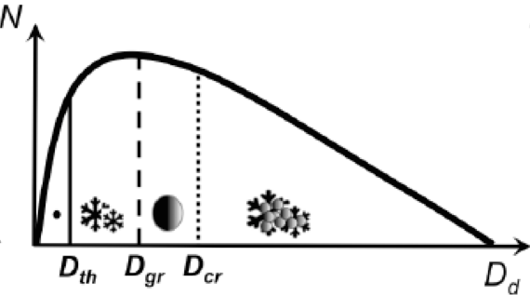
JASON MILBRANDT
My R&D is heavily invested in on-going development and exploration of the P3 microphysics scheme
For operational NWP, the goals are:
Establish P3 as the “flagship” condensation scheme in all MSC NWP systems
Expand the application to exploit prognostic information
e.g. precipitation types, aircraft icing potential, etc.
On-going development includes:
Adjustments for large-scale model applications
Examination of the capacity to simulate/predict hail
Improved physical processes
e.g. secondary ice production
P3 microphysics
parameterization scheme

Slide 37
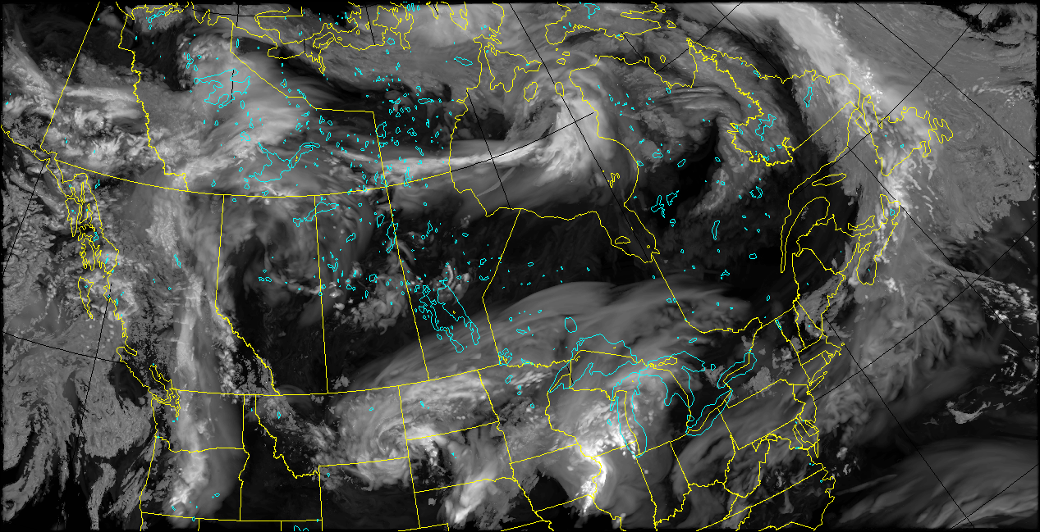
JASON MILBRANDT
Short-time R&D plans include setting up a “passe-parallel maison” (PPM), an in-house, experimental, real-time NWP system (run in user account)
3 domains:
2.5-km (based on operational HRDPS)
Two 1-km domains
Allows on-going testing of new configurations (e.g. P3 versions), full control of output for custom purposes (e.g. comparison to specialized obs, etc.); provides support for various projects (e.g. WINTRE-MIX, testing new HIW diagnostics, etc.)
in-house PPM:

Slide 38
ZHIPENG QU
Research summary
Radiative Transfer
Contribution to the EarthCARE satellite project for the development of radiative closure assessment algorithm;
Development of composite cloud and aerosols product from radar and lidar retrievals;
Development of algorithm for 3D cloud field re-construction based on satellite nadir cloud retrievals;
Preparation of high resolution test scenes for all level 2 algorithm development.
Study of the impact of 3D cloud shadow effect on high resolution simulation;
Impacts on the formation of lake breeze and precipitation.
Study of the possibility of accelerating the radiative transfer calculation for high resolution NWP model.
Use of Partitioned Gaussian Legendre Quadrature (PGLQ) method to reduce the number of radiative transfer calculation.
Observation and Modelling of Cloud Microphysics
Secondary ice production and its impact on deep convection;
Implementation of new secondary ice production parameterization in P3 microphysical scheme;
Tuning/testing of the parameterization with observational data from aircraft (aircraft program).
Validation/evaluation of the simulated cloud properties in high resolution NWP model;
Particular interests of using EarthCARE data (will be launched in 2023);
Particular interests of using data from aircraft observations, such as ICICLE, HAIC-HIWC;
Further contributions to the improvement of P3 microphysical scheme (TBD).

Slide 39
AGENDA
Introductory comments
Individual presentations – inventory of what are each of us doing (w.r.t. CP)
Discussion
Identify common CP sub-topics (areas of overlapping individual research)
Wish-list – other potential CP sub-topics (relevant to OBRS but not yet on-going)
→ Specify the CP research sub-topics (and objectives) that define the program

Slide 40
Identify common CP sub-topics (areas of overlapping individual research)
TENTATIVE
fundamental understanding of cloud microphysical processes
development/improvement of measurement techniques (e.g. probes)
evaluation/verification of model clouds/precipitation based on remote sensing
improved representation of cloud microphysics in NWP

Slide 41
AGENDA
Introductory comments
Individual presentations – inventory of what are each of us doing (w.r.t. CP)
Discussion
Identify common CP sub-topics (areas of overlapping individual research)
Wish-list – other potential CP sub-topics (relevant to OBRS but not yet on-going)
→ Specify the CP research sub-topics (and objectives) that define the program

Slide 42
Wish-list – other potential CP sub-topics (relevant to OBRS but not yet on-going)
Aerosols (representation in CP models)
Li-Barker radiative transfer
parameterization scheme
P3 microphysics
parameterization scheme
Solar radiation
Infrared radiation
Current approach: GUESS
Current approach: TABLES
(and info from r_{eff_c}, r_{eff_i})
Potential topic: Efforts (direct or collaborative) to better incorporate CCN/INP into NWP models (microphysics and RT schemes)

Slide 43
Wish-list – other potential CP sub-topics (relevant to OBRS but not yet on-going)
Aerosols (representation in CP models)
Others?

Slide 44
AGENDA
Introductory comments
Individual presentations – inventory of what are each of us doing (w.r.t. CP)
Discussion
Identify common CP sub-topics (areas of overlapping individual research)
Wish-list – other potential CP sub-topics (relevant to OBRS but not yet on-going)
→ Specify the CP research sub-topics (and objectives) that define the program

Slide 45
OBJECTIVES OF PROGRAM (w.r.t. ECCC mandate)
to improve MRD’s capacity to measure clouds/precipitation
to improve ECCC’s capacity to evaluate NWP models (w.r.t. clouds, precipitation, HIW)
other ?
CLIENTS
RPN/CCMEP (more specific?)
aviation industry (?)
other ?
RESEARCH SUB-TOPICS
fundamental understanding of cloud microphysical processes
development/improvement of measurement techniques (e.g. probes)
evaluation/verification of model clouds/precipitation based on remote sensing
representation of clouds, precipitation, and HIW in NWP

